Slide 1
Technology & Innovation Strategy Formulation
Case Focus: Google Inc. in the age of AI

Slide 2
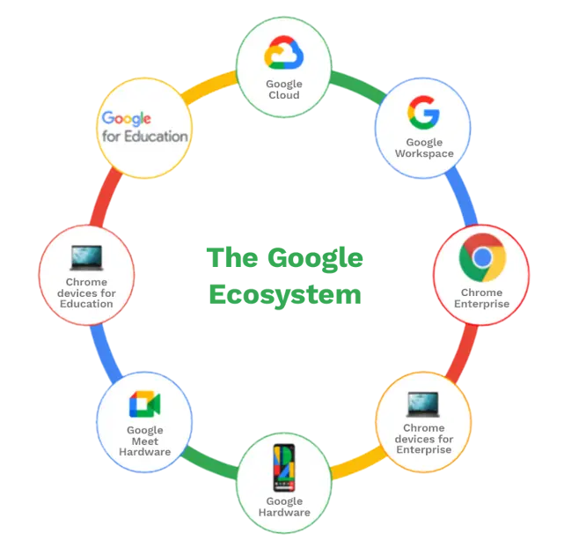
Technology & Innovation Strategy Formulation
Using frameworks: SWOT, PESTEL, Porter’s Five Forces.
Theories: Porter & Resource-Based View (RBV).
Case: Google in the Age of AI.

Slide 3
Learning Objectives
By the end of this lecture, you should be able to:
Explain why strategy matters in tech industries.
Apply SWOT, PESTEL, Five Forces to a real firm.
Understand Porter’s and RBV theories.
Critically analyze Google’s diversification into AI, hardware, and cloud.
Discuss ethical and societal issues in AI.

Slide 4
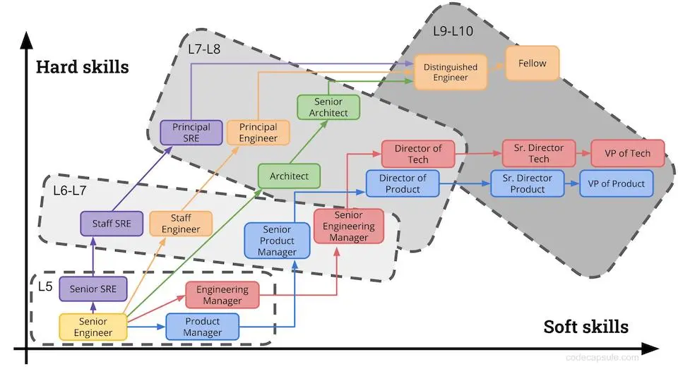
Why This Matters for You
As CS/Data Science/Informatics students:
Strategy explains why firms invest in certain tech.
Helps you link technical work to business outcomes.
Builds skills for leadership roles, not just technical jobs.

Slide 5
Outline of Lecture
Introduction to Strategy.
Frameworks (SWOT, PESTEL, Five Forces).
Theories (Porter & RBV).
Google Case Context.
Google SWOT/PESTEL Analysis.
Case Extension: Google in the Age of AI.
Ethical Issues & Class Activity.
Lessons Learned & Wrap-up.

Slide 6
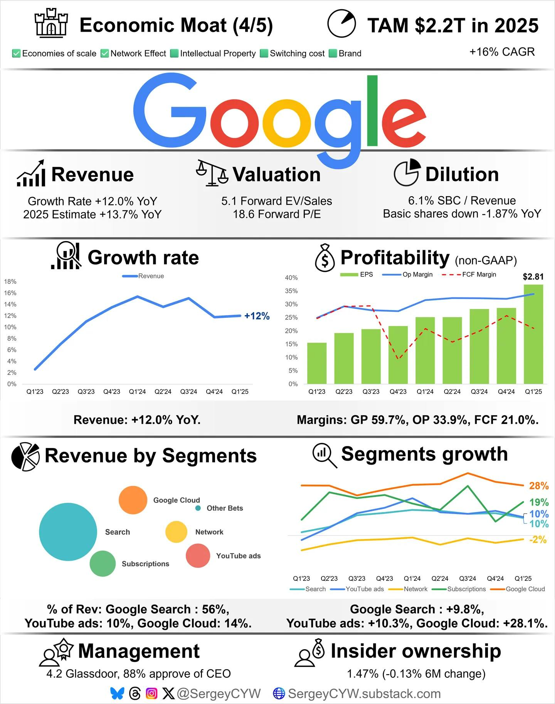
What is Strategy?
Strategy = long-term plan for success.
For tech firms:
Which markets to serve?
Which technologies to develop?
How to beat competitors?
Example: Google moving from search → ads → AI + cloud.

Slide 7
Why Strategy Matters in Tech
Tech changes faster than traditional industries.
Without strategy:
Wasted R&D and disruption risks
With strategy:
Sustainable growth (e.g., Amazon from books → cloud).

Slide 8
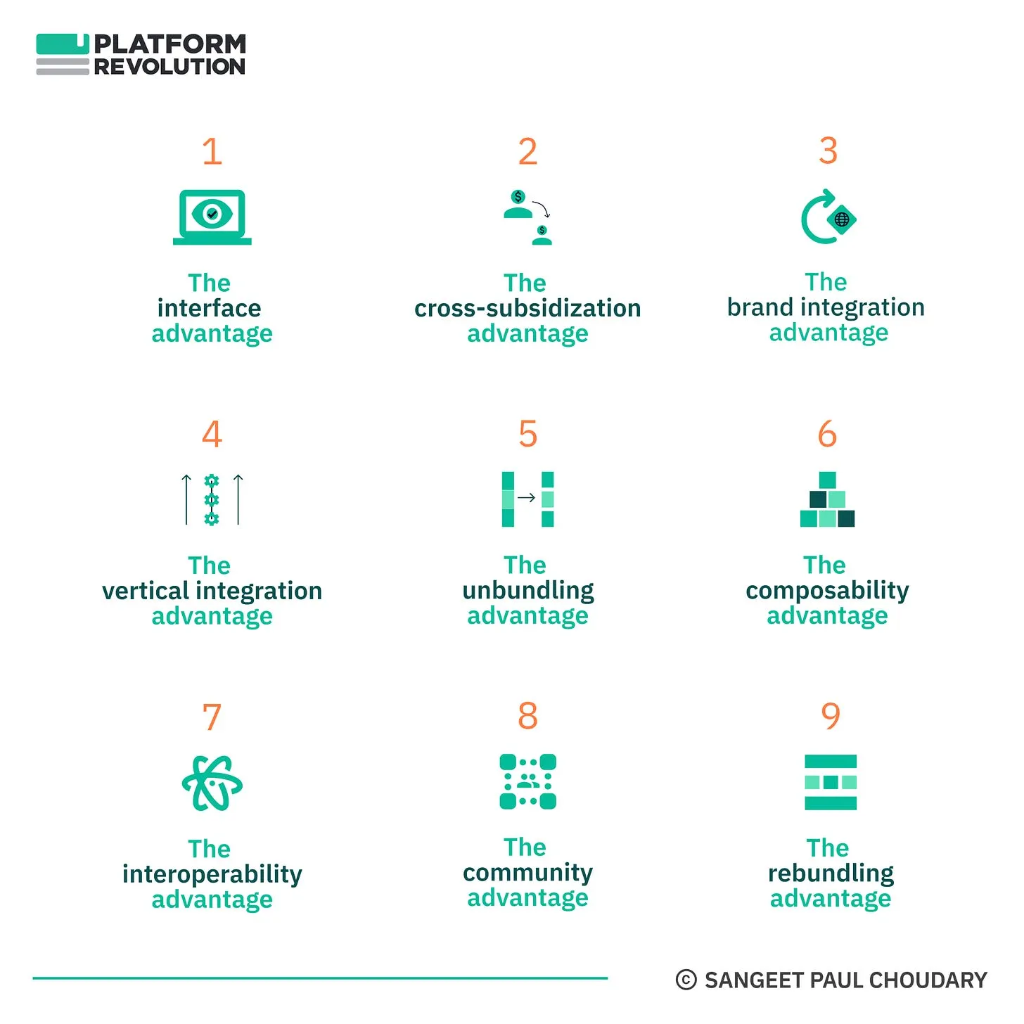
Strategy Frameworks Overview
SWOT = strengths/weaknesses + opportunities/threats.
PESTEL = external environment forces.
Porter’s Five Forces = industry competition.
RBV = internal resources/capabilities.

Slide 9
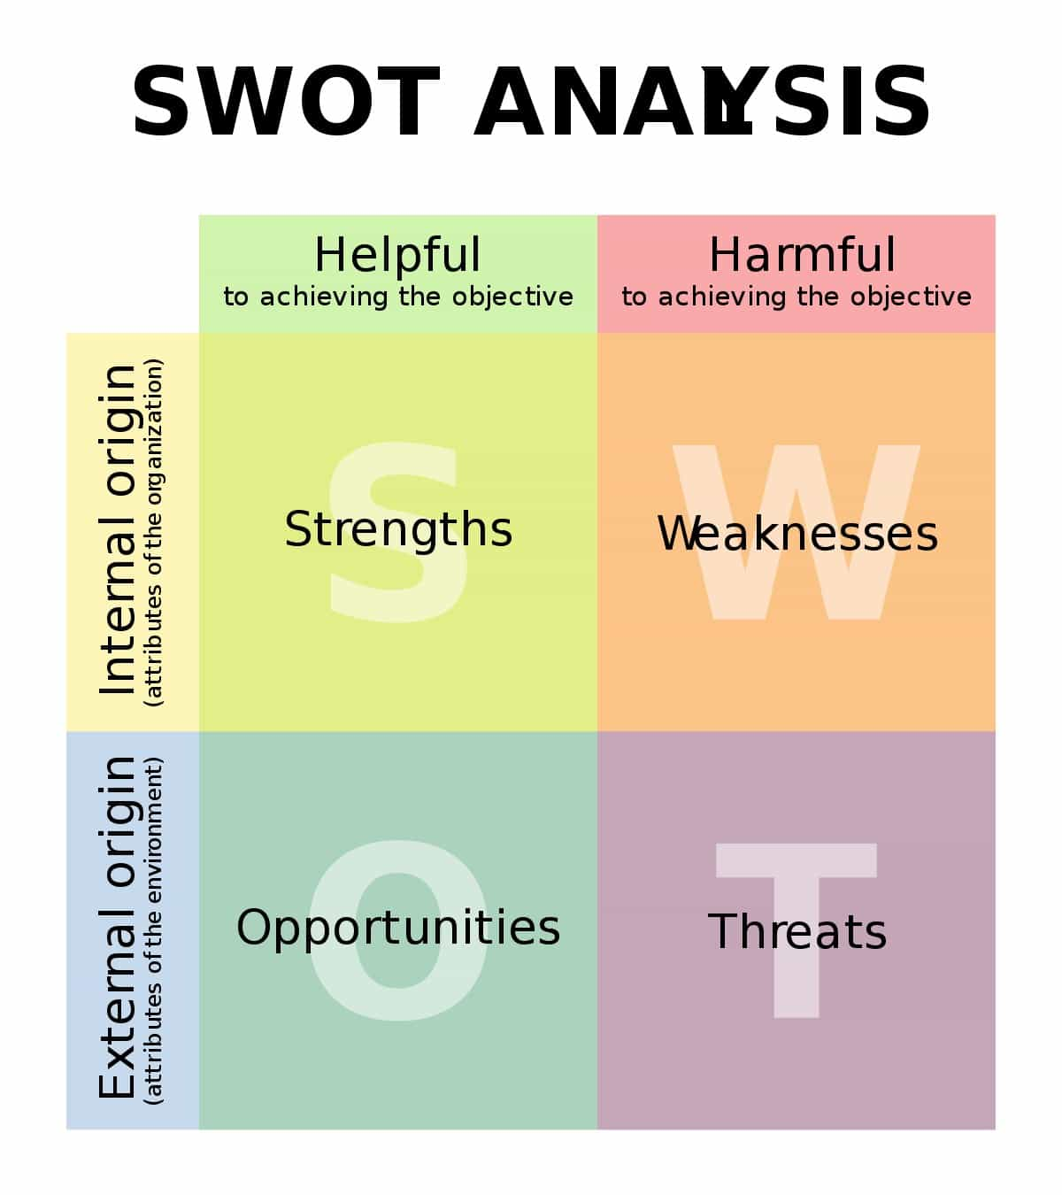
SWOT Analysis Explained
Strengths:
What firm does well?
Weaknesses:
Where does firm struggle?
Opportunities:
Favorable external trends.
Threats:
External risks/challenges.

Slide 10
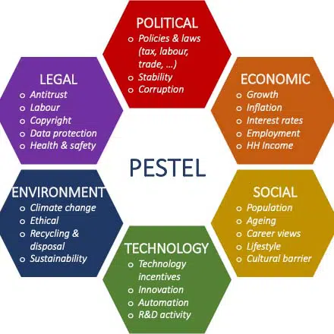
PESTEL Analysis Explained
Political: Government rules, taxes, trade wars.
Economic: Inflation, recession, growth opportunities.
Social: User behavior, cultural trends.
Technological: AI, blockchain, cloud, IoT.
Environmental: Carbon emissions, green IT.
Legal: Privacy laws, IP rights, antitrust.

Slide 11
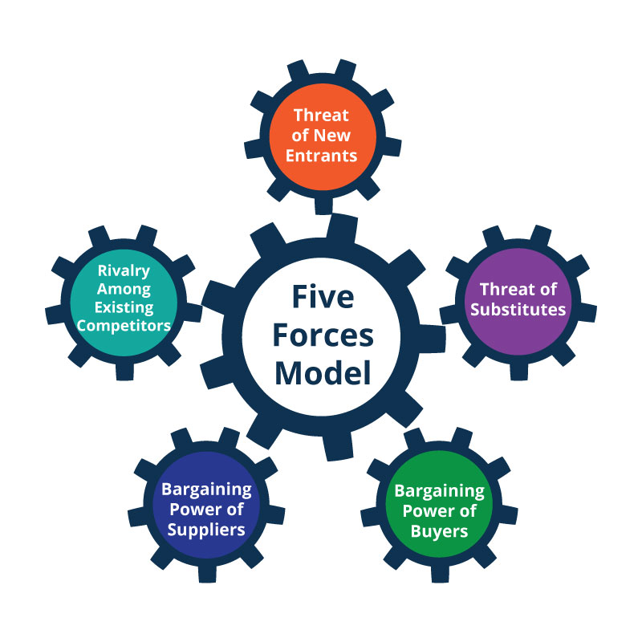
Porter’s Five Forces
Rivalry among competitors.
Threat of new entrants.
Threat of substitutes.
Bargaining power of suppliers.
Bargaining power of buyers.

Slide 12
Porter’s Five Forces: Example – Smartphone Industry
Rivalry: Apple, Samsung, Xiaomi.
New entrants: Very hard (patents, cost).
Substitutes: Tablets, wearables.
Suppliers: TSMC (chips), Foxconn.
Buyers: Consumers switch easily.

Slide 13
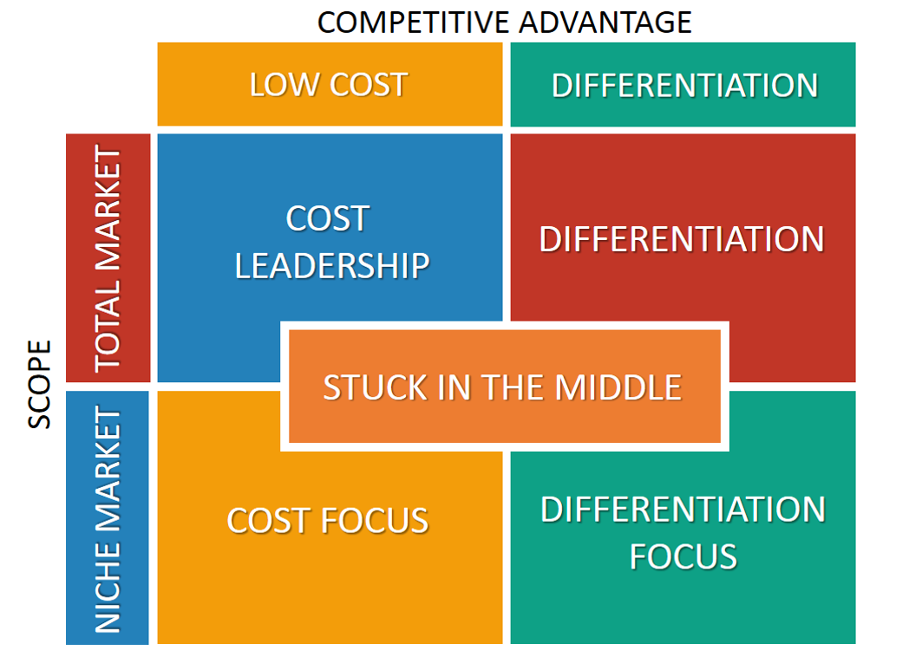
Theory – Porter’s Competitive Strategy
Firms compete by:
Cost leadership (cheapest).
Differentiation (unique features).
Focus (niche markets).
Strategy = choosing a position and sticking to it.

Slide 14
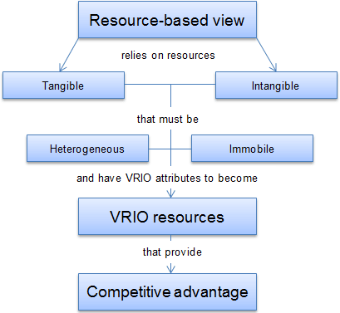
Theory – Resource-Based View (RBV)
Advantage = internal resources & capabilities.
VRIO test: Valuable, Rare, Inimitable, Organized.
Example: Google’s global data + AI talent = unique advantage.

Slide 15
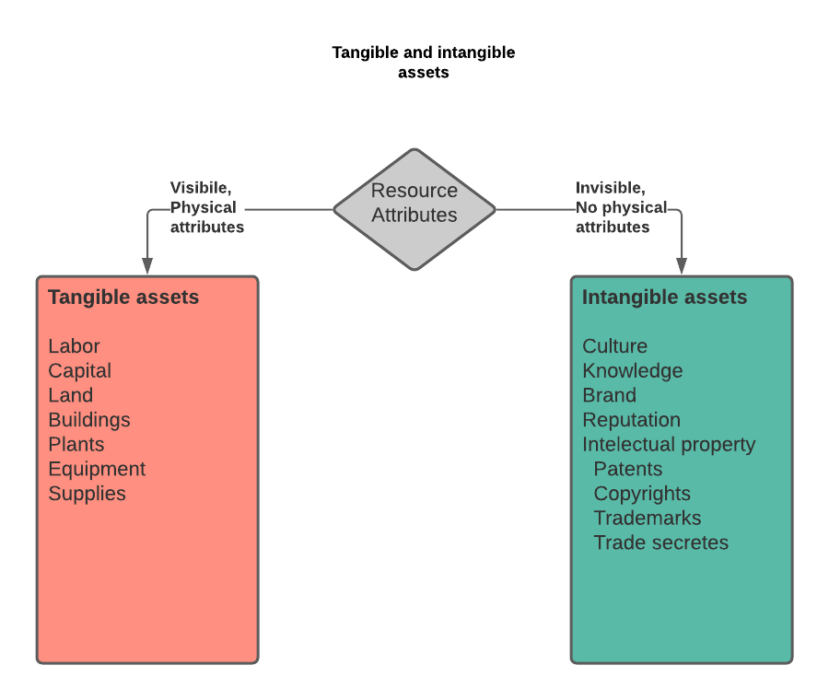
Theory – Resource-Based View (RBV)
Advantage = internal resources & capabilities.
VRIO test: Valuable, Rare, Inimitable, Organized.
Example: Google’s global data + AI talent = unique advantage.

Slide 16
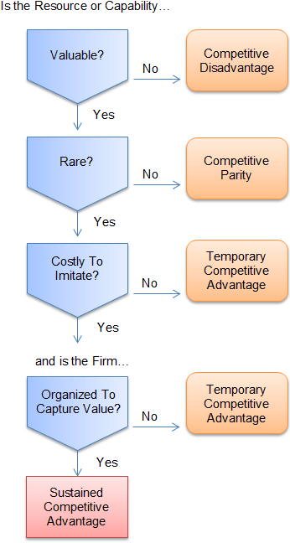
Theory – Resource-Based View
Advantage = internal resources & capabilities.
VRIO test: Valuable, Rare, Inimitable, Organized.
Example: Google’s global data + AI talent = unique advantage.
https://strategicmanagementinsight.com/tools/resource-based-view/

Slide 17
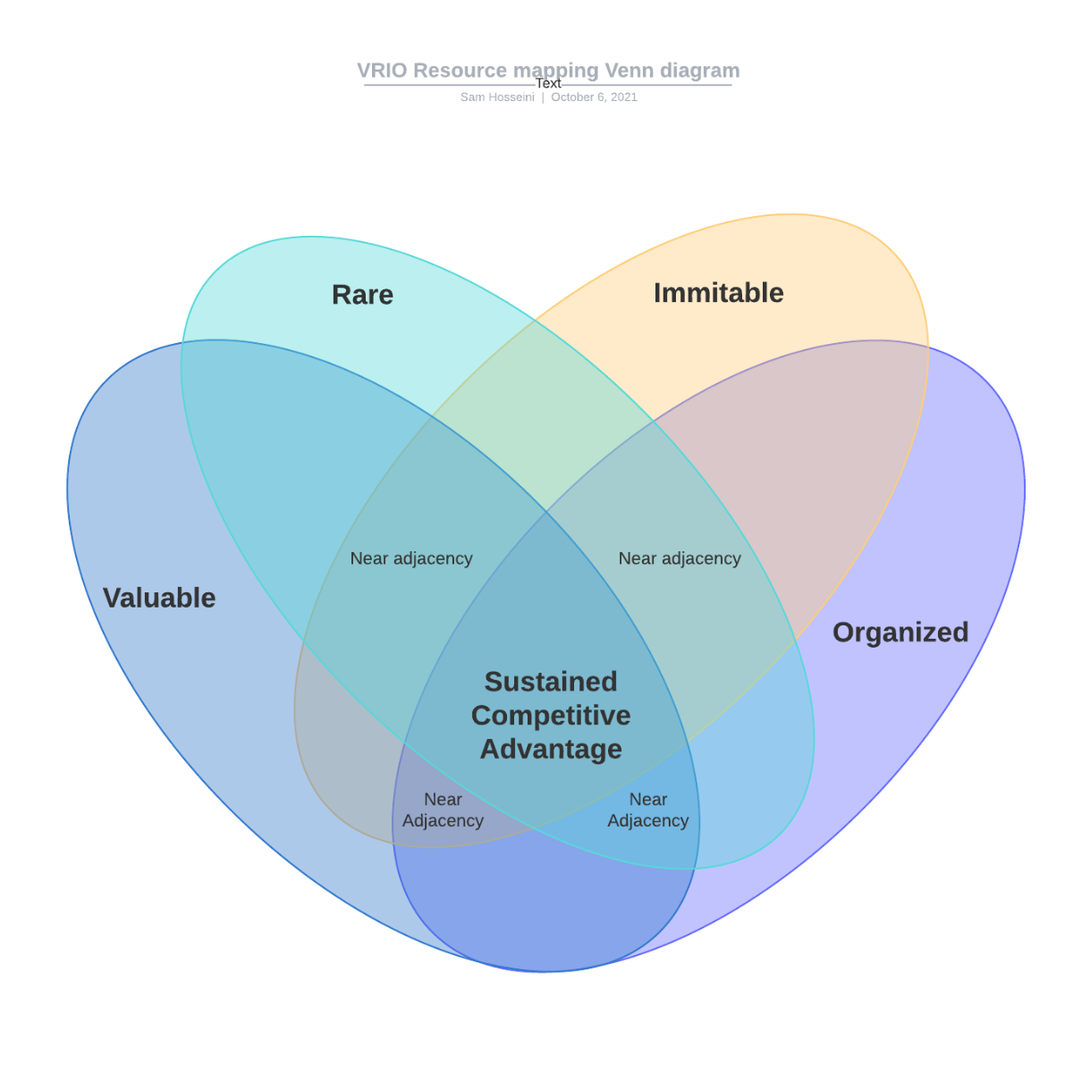
Theory – Resource-Based View (RBV)
Advantage = internal resources & capabilities.
VRIO test: Valuable, Rare, Inimitable, Organized.
Example: Google’s global data + AI talent = unique advantage.
https://www.synrgix.com/posts/resource-based-view/

Slide 18
Combining Frameworks
External view = PESTEL + Five Forces.
Internal view = SWOT + RBV.
Strategy = combining inside & outside perspectives.

Slide 19
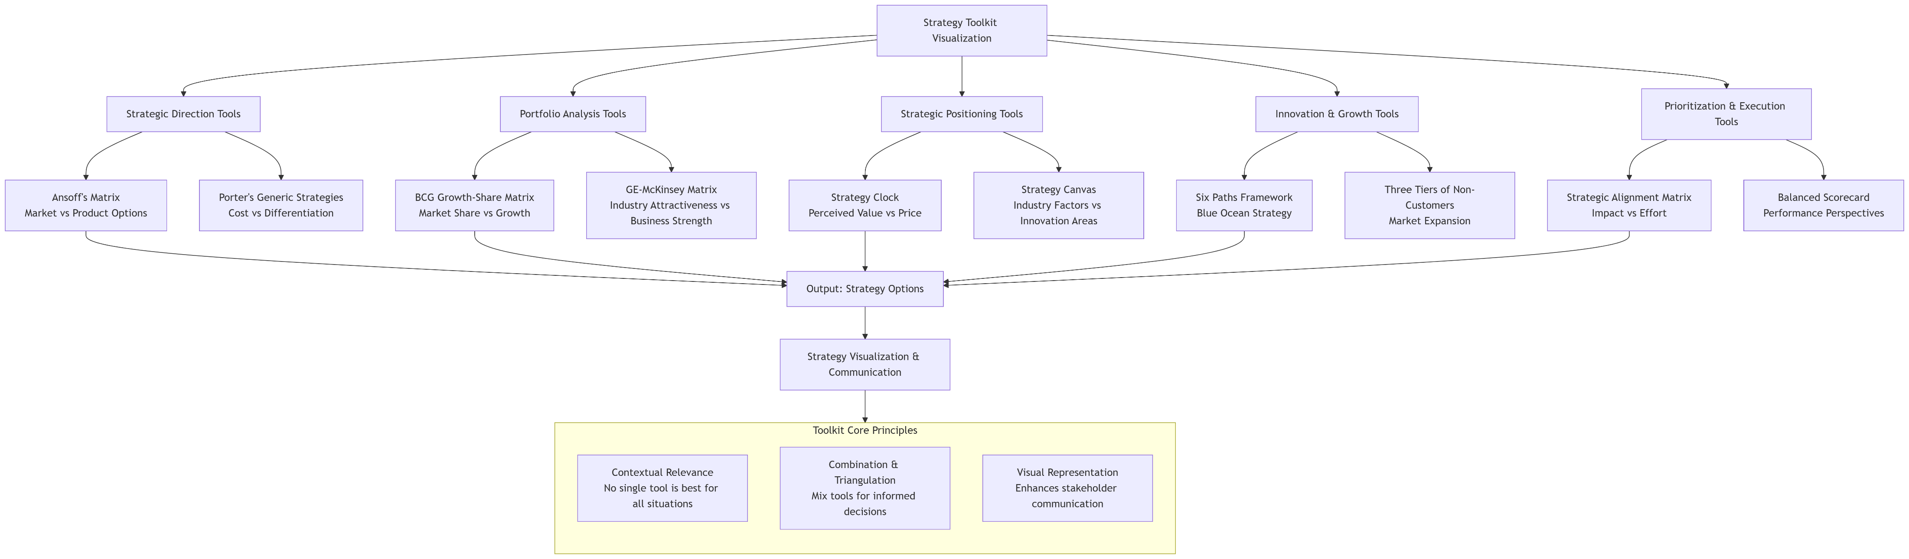
Combining Frameworks
https://gradmode.com/using-a-strategy-toolkit-for-better-strategy-visualization/

Slide 20
Case Study Focus – Google Inc. in the age of AI
Founded 1998 (search engine).
Now in:
Ads (Google Ads, YouTube).
Cloud (GCP).
Hardware (Pixel, Nest).
AI (DeepMind, Bard, Gemini).

Slide 21
Google’s Strategic Challenges
Reliance on ads for revenue.
Competition: Microsoft, Apple, Amazon.
Regulation: Antitrust, privacy rules.
Balancing innovation vs. stability.

Slide 22
Google SWOT – Strengths
Strong brand, global reach.
Market leader in search.
AI expertise (DeepMind, Gemini).
Huge financial resources.
Ecosystem: Android, Chrome, YouTube.

Slide 23
Google SWOT – Weaknesses
Dependence on ad revenue.
Failed hardware launches (Glass, Stadia).
Bureaucratic culture.
Data privacy reputation issues.

Slide 24
Google SWOT – Opportunities
Cloud market growth.
AI-driven products.
Smart homes & IoT.
AR/VR and new markets.

Slide 25
Google SWOT – Threats
Microsoft + OpenAI in AI.
Global regulations.
TikTok/ChatGPT changing search habits.
Cybersecurity risks.

Slide 26
Google PESTEL – Political & Economic
Political: Antitrust lawsuits, geopolitics.
Economic: Global inflation, currency risk.

Slide 27
Google PESTEL – Social & Technological
Social:
Gen Z using TikTok for search.
Technological:
Generative AI race, cloud innovation.

Slide 28

Google PESTEL – Environmental & Legal
Environmental:
Data center energy use.
Legal:
GDPR, monopoly lawsuits.

Slide 29
Google – Porter’s Five Forces
Rivalry: Intense (Amazon, Microsoft, Apple).
New entrants: AI startups.
Substitutes: ChatGPT, TikTok.
Suppliers: Chipmakers.
Buyers: Advertisers & cloud clients.

Slide 30
Google’s RBV
Valuable: Proprietary data & AI models.
Rare: YouTube + search dominance.
Inimitable: Infrastructure scale.
Organized: Alphabet structure.

Slide 31
Synthesis of Analysis
Strengths + Opportunities: Grow cloud & AI.
Weaknesses + Threats: Reduce ad dependence.
Strategy = balance sustaining ads with disruptive AI bets.

Slide 32
Case Study Extension – Google Inc. in the Age of AI
Core dilemma: Protect profitable search while adapting to disruptive AI.
Competitors: Microsoft + OpenAI.
Google response: Bard (Gemini), more AI investment, internal restructuring.
Tension: Disruption vs. sustaining innovation.

Slide 33
Disruptive vs. Sustaining Innovation
ChatGPT = disruptive (new way to search).
Bard = sustaining (protects search/ads).
Lesson: Even tech giants can face disruption.

Slide 34
Technology Sourcing Strategies
Google = Make (internal R&D: Brain, DeepMind).
Microsoft = Ally (OpenAI partnership).
Key Q: Should Google open up to alliances?

Slide 35
Ethical & Societal Issues in AI
Ethical:
Misinformation, bias, privacy concerns.
Societal:
Job shifts, education disruption, unequal access.
Responsibility:
Innovate without breaking trust.

Slide 36
Theoretical Lens on the Case
Christensen’s Disruptive Innovation: ChatGPT as classic disruption.
Porter’s Five Forces: AI increases rivalry & substitutes.
Open Innovation: Microsoft’s alliance model vs. Google’s internal-first.

Slide 37
Class Activity – Group Work
Divide into groups:
Group A: SWOT on Google AI strategy.
Group B: PESTEL (focus on AI).
Group C: Role-play debate – Google vs. Microsoft vs. Regulators.
Present back in 4–5 minutes.

Slide 38
Google Inc. in the age of AI – Discussion Questions
Should Google prioritize protecting ads or pushing AI innovation?
How could alliances have helped Google?
What ethical guardrails should Google enforce?
Is Google’s bureaucracy a strength or weakness?
Could open-source AI disrupt both Google and Microsoft?

Slide 39
Lessons Learned
Frameworks help analyze strategy.
Google shows both strengths and vulnerabilities.
Disruption is real, even for tech leaders.
Ethics & responsibility are central in AI strategy.

Slide 40
Readings & References
Kohli & Krstovski (2025): Google in the Age of AI. Columbia Business School
HBR (2020): “Competing in the Age of AI.”
Ateljevic et al. (2023): Business Strategy and Competitive Advantage. Routledge. Ch. 3.

